Slide 1

Chapter 2 ~ Digital Image Fundamentals
Created By
S. M. Mahedy Hasan Assistant Professor, Dept. of CSE RUET, Rajshahi-6204, Bangladesh.
Modified by
Md. Manirujjaman
Lecturer, Dept. of CSE
DIU, Satarkul, Badda, Dhaka

Slide 2
Sampling and Quantization
To create a digital image, we need to convert the continuous sensed data into digital form. This involves two processes:
  Sampling
  Quantization
An image may be continuous with respect to the x- and y-coordinates, and also in amplitude.
Digitizing the coordinate values is called sampling.
Digitizing the amplitude values is called quantization.

Slide 3
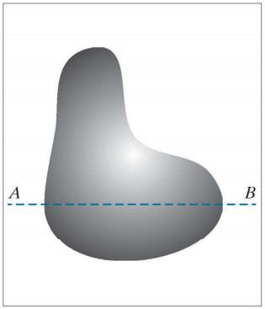
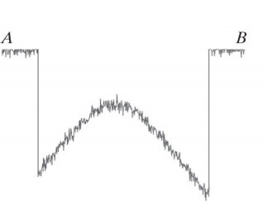
Sampling and Quantization
The one-dimensional function in Fig. (2) is a plot of amplitude (intensity level) values of the continuous
image along the line segment AB in Fig. (1).
Figure 1: Continuous image
Figure 2: A scan line showing intensity variations along line AB in the continuous image.

Slide 4
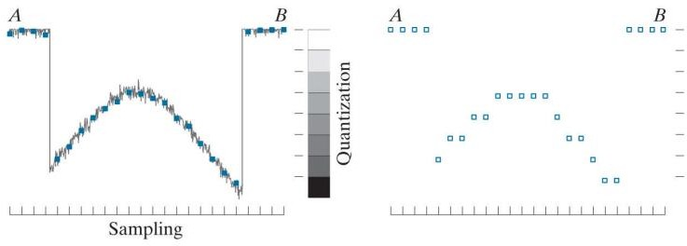
Sampling and Quantization
To sample this function, we take equally spaced samples along line AB, as shown in Figure.
In order to form a digital function, the intensity values also must be converted (quantized) into discrete quantities.
The right side of Fig. a shows the intensity scale divided into eight discrete intervals, ranging from black to white.
The digital samples resulting from both sampling and quantization are shown in the following figure.
Figure 3: Sampling and Quantization

Slide 5
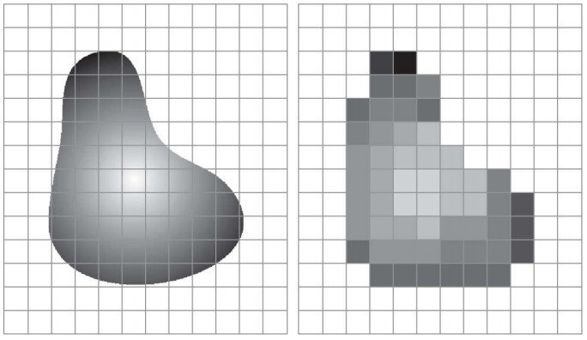
Sampling and Quantization
In practice, the method of sampling is determined by the sensor arrangement used to generate the image.
  Single Sensor – Sampling depends on Motion
  Strip Sensor – Number of Sensor and Motion
  Array Sensor – Number of Sensor
The following figure 4 illustrates Quantization of the sensor outputs.
Figure 4: (a) Continuous image projected onto a sensor array. (b) Result of image sampling and quantization

Slide 6
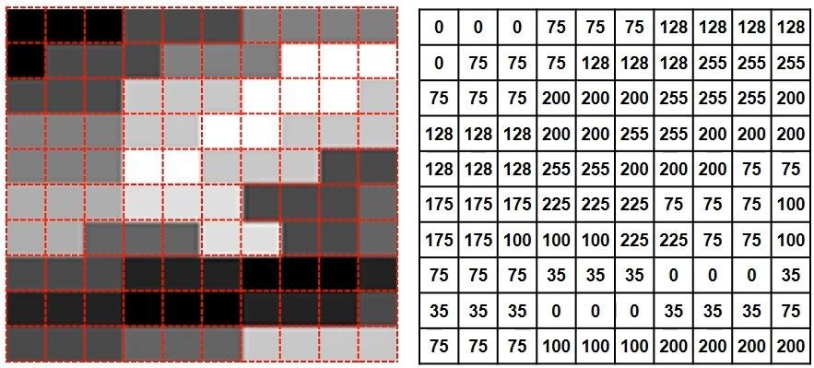
Sampling and Quantization
Figure 5: Effect of sampling and quantization

Slide 7
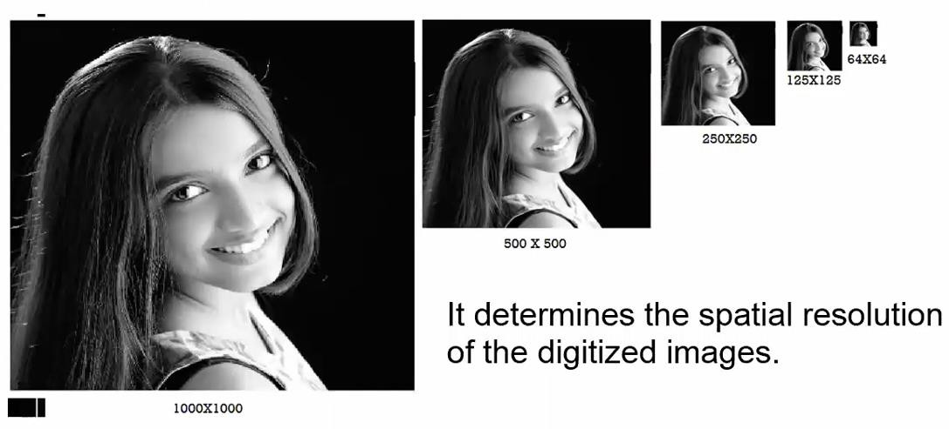
Sampling and Quantization
It determines the spatial resolution of the
digital images.

Slide 8
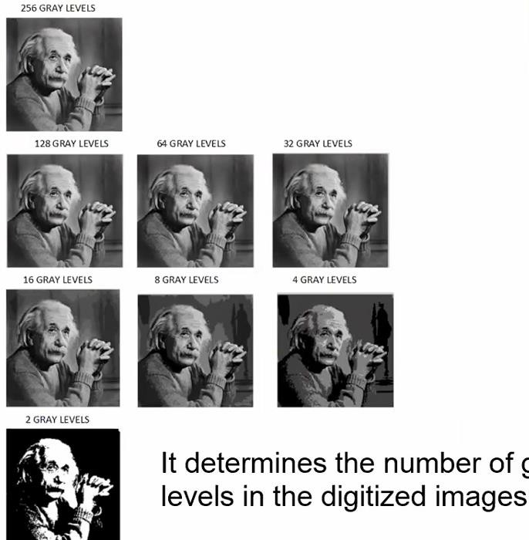
Sampling and Quantization
It determines the number of the gray levels
in the image.

Slide 9
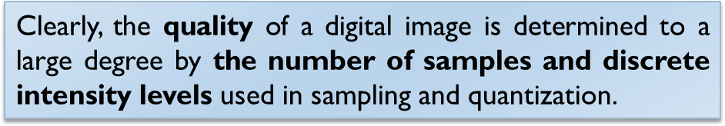
Sampling and Quantization

Slide 10
Representation of Digital Image
Sampling and Quantization
f(s,t) - A continuous image function
of two continuous variables, s and t.
A 2-D array, f(x,y), containing M rows and
N columns, where are discrete coordinates.
In general, the value of the image at any coordinates (x,y) is denoted f(x,y), where x and y are integers.
The section of the real plane spanned by the coordinates of an image is called the spatial domain, with x and y
being referred to as spatial variables or spatial coordinates.

Slide 11
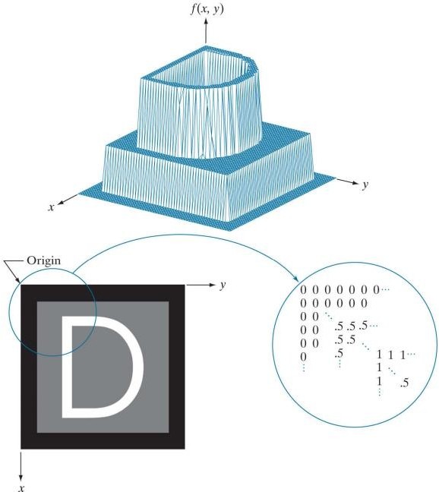
Representation of Digital Image
Figure 6: (a) Image plotted as a surface. (b) Image displayed as a visual intensity array. (c) Image shown as a 2-D numerical array. (The numbers 0, .5, and 1 represent black, gray, and white, respectively.)

Slide 12
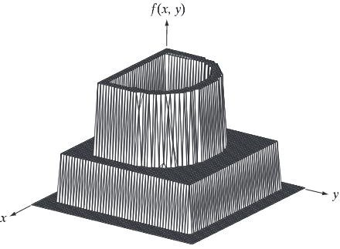
Representation of Digital Image
This type of representation has three axis. Where, x and y are the spatial co-ordinates and f(x, y) represents another co-ordinates.
Here, f(x, y) is a function of spatial co-ordinates (x, y).
This type of representation is not always preferable.
Complex images having too many details, make the interpretation of images with this type of representation very difficult.
Figure 7: Image plotted as surface

Slide 13
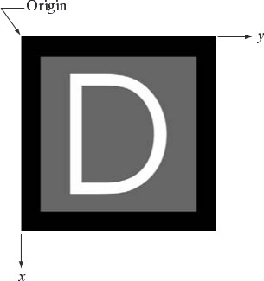
Representation of Digital Image
It would appear on a monitor or photograph.
There are only three discrete intensity values (black, grey and white). If the intensity is normalized to the interval [0, 1], then each point in the image has the value 0, 0.5, or 1.
This type of representation is used for printers.
Figure 8: Image plotted visual intensity array

Slide 14
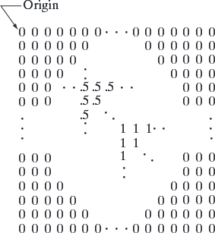
Representation of Digital Image
Representation is simply to display the numerical values of as an array (matrix).
Most widely used representation in digital image processing.
Figure 9: Image shown as a 2-D numerical array (0, 0.5, and 1 represent black, gray, and white, respectively).

Slide 15
Representation of Digital Image
Image can also be represented as matrix.
Each element of this matrix is called an image element, picture element, pixel, or pels.
Note:
Image – a digital image Pixel – its elements.
⎡
⎢
f (0,0)
f (1,0)
f (0,1)
f (1,1)
⁝
f (M −1,1)
☹ f (0, N −1)
☹ f (1, N −1)
⎤
⎥
⎥
f (x, y) = ⎢
⎢
⁝
⁝
⎥
⎢ f (M −1,0)
☹ f (M −1, N −1)⎥
⎣
⎦ M ×N

Slide 16
Representation of Digital Image
However, due to storage and quantizing hardware considerations, the number of intensity levels
typically is an integer power of 2:
L = 2^{k}
Interval [0 to L-1].
Dynamic intensity range = Maximum measurable intensity level / minimum detectable intensity level.
Maximum measurable intensity level is called saturation, this means that the intensity level beyond this saturation level is clipped off.
Minimum detectable intensity level is called noise, this means that the intensity level below this noise level is not a true intensity value.

Slide 17
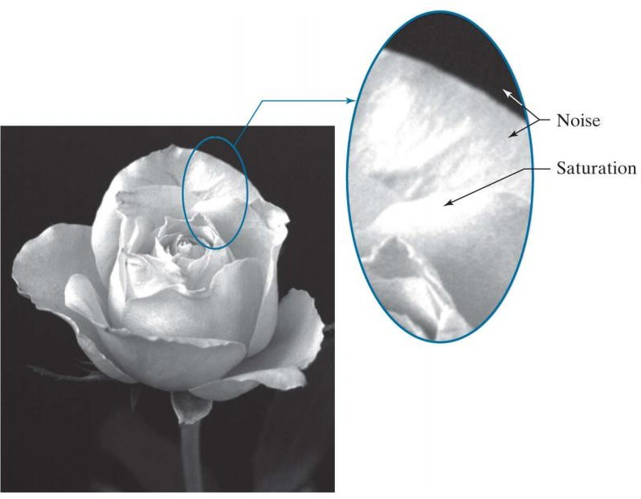
Representation of Digital Image
Sometimes, the range of values spanned by the gray scale is referred to informally as the dynamic range.
We define the dynamic range of an imaging system to be the ratio of the maximum measurable intensity to the minimum detectable intensity level in the system.
As a rule, the upper limit is determined by saturation and the
lower limit by noise.
Closely associated with this concept is image contrast, which we define as the difference in intensity between the highest and lowest intensity levels in an image.
Figure 10: Saturation and Noise

Slide 18
Representation of Digital Image
When an appreciable number of pixels in an image have a high dynamic range, we can expect
the image to have high contrast.
Conversely, an image with low dynamic range typically has a dull, washed-out gray look.

Slide 19
Thank You ☺

